Slide 1
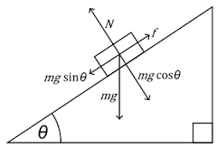

Voyage of The Outlaws!
Incline studios
Krazykatz.inc
By Jason Pearson & Khandker Hussain

Slide 2
Overview: “Voyage of the Outlaws!”
The purpose of the game:
Collect 10 fusion cores to advance
Collect as many loose element to score points
Importantly to survive waves of enemies
This is an arcade style game
This game’s style derived from our 3rd assignment

Slide 3
Planning stage
INSERT WIREFRAMES?

Slide 4
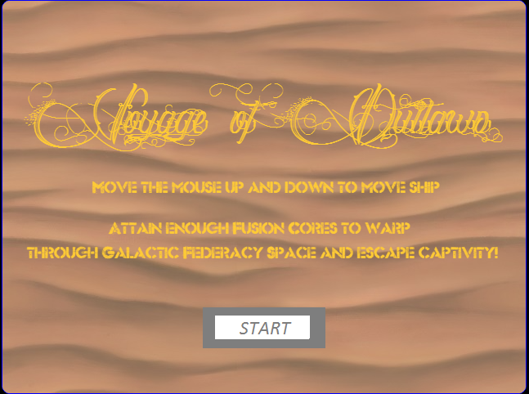
Instruction information
Basic Instruction screen snapshot from level01

Slide 5
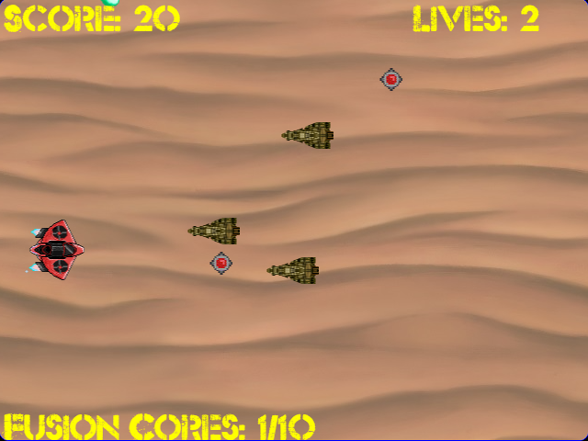
Level01 – Desert Planet of K’troth

Slide 6
Level02 – Forest Eco-Sphere

Slide 7
Level03 – Space

Slide 8
Lessons learned
We’re a couple of fucktards
Better time management skills

Slide 9
Future possibilities
Create leaderboards and final highscore for each level

